Slide 1
MGM Institute of Physiotherapy Aurangabad
MAHATMA GANDHI MISSION
Didactic Lecture

Slide 2
Cervical special tests
Dr. surendra Wani
Dept. Of Musculoskeletal Physiotherapy
MGM Institute Of Physiotherapy
Chh. Sambhajinagar

Slide 3
Objectives
To understand and demonstrate the procedure for performing Cervical spine special tests.

Slide 4
Distraction test :-
Purpose :- cervical radiculopathy
Test position :- supine or sitting upright
Technique :-
Positive test :- if pain is relieved .
If increased pain :- muscle spasm ,sprain ,strain etc

Slide 5
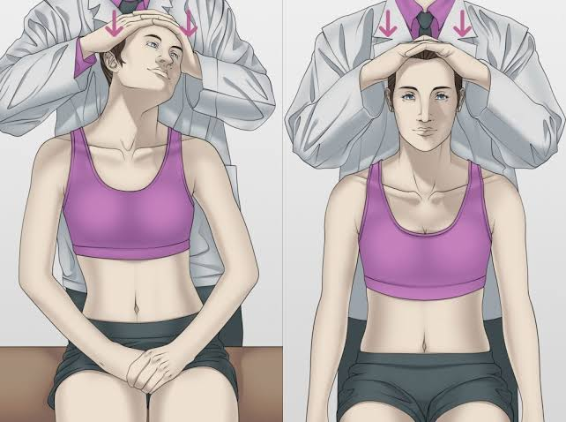
Foraminal compression (Spurling’s) test :-
Test position :- upright sitting
Technique :-
1st stage :- compression with head in neutral
2nd stage :- axial compression with head in extension
3rd stage :- axial compression with head in extension and rotation .
Positive test :- provoke symptoms
Stenosis, cervical spondylosis , osteophytes, inflamed

Slide 6
Upper limb neurodynamic tests :-

Slide 7
ULNT1:-

Slide 8
ULNT2 :-

Slide 9
ULNT3 :-

Slide 10
ULNT4 :-

Slide 11
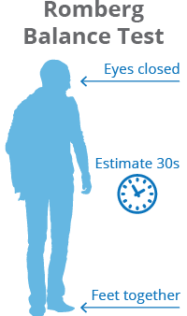
Romberg test :-
Test position :- standing with eyes closed.
Position held for 20-30sec.
If body begins to sway excessively or patient loses balance , test is considered positive for an upper motor neuron lesions.

Slide 12
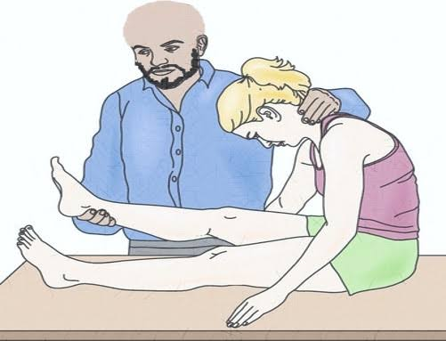
Lhermitte sign :-
For UMN lesion
Test position : long sitting position.
Procedure:-
Positive test :- sharp , electric shock like pain down the spine
Indicates meningeal irritation or cervical myelopathy .

Slide 13
Tests for vascular signs and symptoms :-
Vertebral artery ( cervical quadrant ) test :-

Slide 14
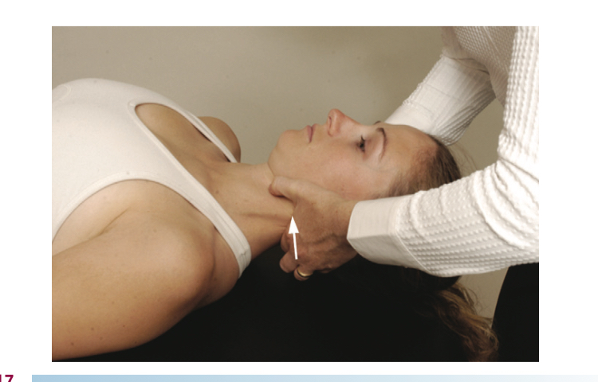
Test for cervical instability :-
Anterior shear or sagittal stress test :-
To test integrity of supporting ligamentous & capsular tissues of cervical spine.
Patient position : supine with head in neutral.
Test procedure :-
Positive test :- nystagmus, pupillary changes, dizziness, soft end feel, nausea , facial or lip paresthesia .

Slide 15
SUMMARY & Questions
Describe the types of ULTT in details. 7 Marks
Special tests for cervical spondylosis.
Quadrant test

Slide 16
